Slide 1
Chapter initial interest meeting

Slide 2
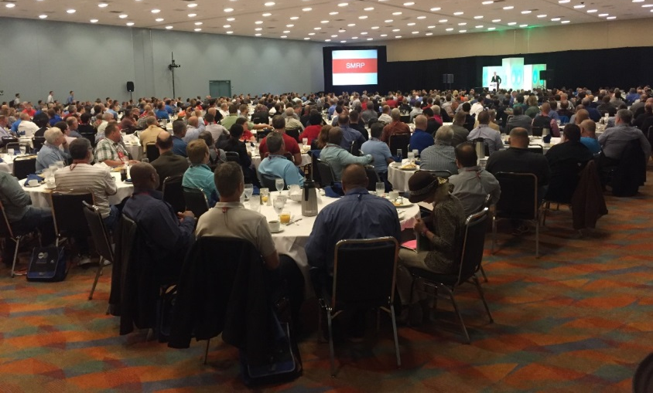
About SMRP
Chartered in 1992 as a nonprofit organization “By Practitioners, For Practitioners” to advance the maintenance, reliability and physical asset management profession
Offers world-class excellence through CMRP, CMRT and CAMA certifications
Currently 6,000+ members across six continents

Slide 3

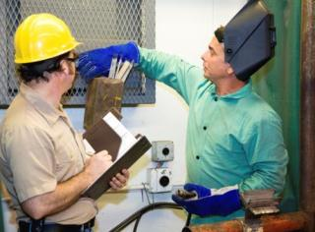
Mission, Vision & Values
Mission:
To develop and promote excellence in maintenance, reliability and physical asset management
Vision:
To be the global leader for maintenance, reliability and physical asset management
Values
Data driven
Sharing/Collaboration
Member-focused
Continuous Improvement
Accountability
Integrity
Trust & Respect
Social Responsibility

Slide 4
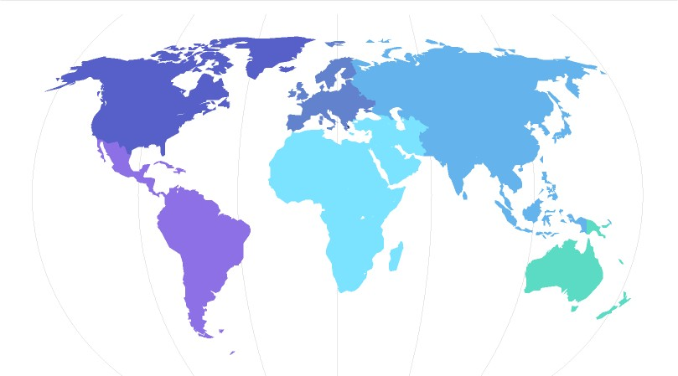
Over 6,000 Members Around the Globe
85%
2%
2%
5%
4%
2%

Slide 5
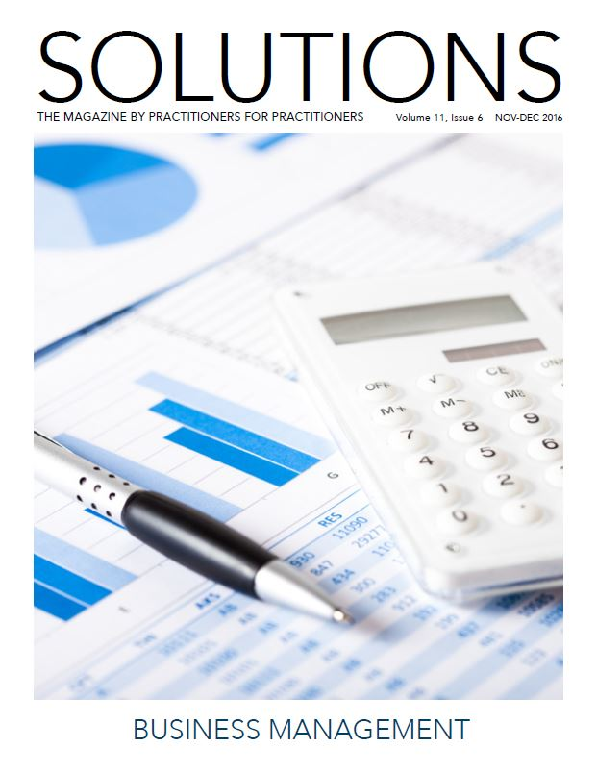
Membership Benefits
Educational webinars and workshops
Best practices
Solutions magazine
Annual Conference attendance
Online job board
Recognized certifications
Membership directory
Local chapter and Shared Interest Groups (SIG) membership
Scholarship/Award opportunities

Slide 6
SMRP Chapters
Benefits of joining a chapter:
  Education and networking opportunities on a local, regular basis
  Chapter Question Writing Contest
  Gain leadership experience by becoming involved

Slide 7
Current Chapters
Alabama
Allegheny/Appalachian
Arizona
Carolinas
Chicagoland
Detroit-Windsor
East Tennessee
Florida
Georgia
Greater Cincy/N. Kentucky
Houston
Indiana
Kansas City
Middle Tennessee
Nebraska/Iowa
North Texas
Ontario
SE Virginia
South Central
Trinidad
Wichita

Slide 8
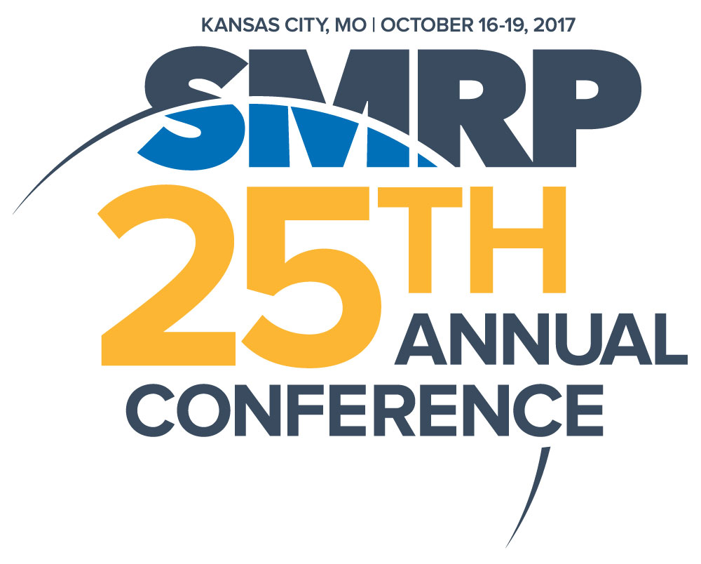
Annual Conference
One of the largest maintenance, reliability and physical asset management conferences in North America
Attracts over 1,000 participants for educational workshops, track sessions, networking and unique facility tours
Expert keynote addresses from industry leaders

Slide 9
Job Board
Employers can:
  Post jobs
  Browse/search resumes
  Manage posts
  Resume email alerts
  Reporting
Job seekers can:
  Review job postings
  Submit resumes
  Apply for jobs online
  Job email alerts
  Save jobs

Slide 10

SMRPCO
Offers CMRP, CMRT and CAMA
Exam questions based on SMRP’s Body of Knowledge (BoK) and its five pillars
Statistically analyzed and overseen by a professional psychometrician

Slide 11
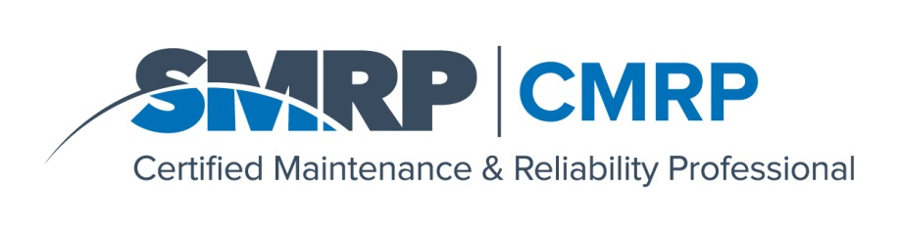
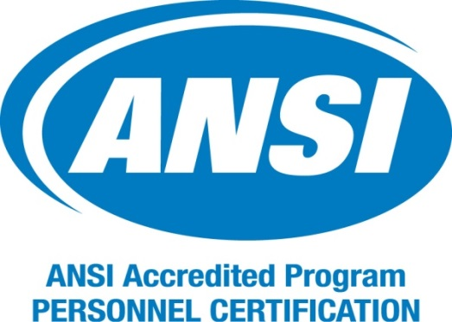
ANSI Accreditation
CMRP is the only maintenance, reliability and physical asset management certification exam accredited by the American National Standards Institute (ANSI)

Slide 12
CMRP Exam
110 multiple choice questions
Test relevant, real-world work experience
Five key subject areas form the BOK:
  Business & Management
  Manufacturing Processes
  Equipment Reliability
  People Reliability
  Work Management
CMRP designation gives you greater earning potential and improves career opportunities

Slide 13
Electronic Testing
Through partnership with Kryterion, the CMRP exam is available at computer-based testing facilities
Great for professionals outside North America

Slide 14
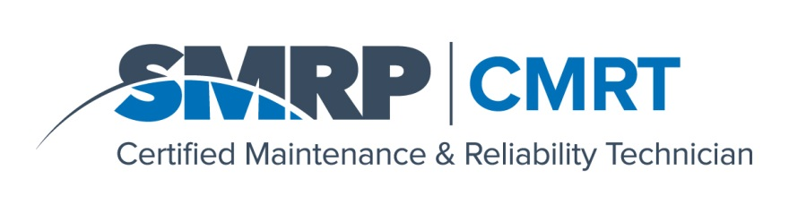
CMRT Exam
175 multiple choice questions
Four key subject areas from BoK:
  Maintenance Practices
  Preventative and Predictive Maintenance
  Troubleshooting
  Analysis and Corrective Maintenance
CMRT designation gives you job skills and knowledge that translate across different industries and companies

Slide 15

CAMA Exam
110 multiple choice questions
Questions based on ISBN978 0 9871799 3 7 GFMAM_ISO55001 Auditor Assessor Specification
Recognized in North America, Australia, France and Brazil
Applicants should have working knowledge of ISO 5500X standards
The CAMA certification establishes an individual’s credentials in global asset management knowledge and comprehension

Slide 16



Ready to Join?
1-800-950-7354
info@smrp.org
www.smrp.org

Slide 17
SMRP Staff Contacts
Jane Siggelko
Manager, Programs & Services
678-303-2988
jsiggelko@smrp.org
Erin Erickson
Executive Director
720-881-6118
eerickson@smrp.org
Matt Vieson
Associate Director
678-303-2983
eerickson@smrp.org

